Slide 1
COEN 380 – Spring2015
Group 2
Abhilasha Sahu (W1103561)
Aditee Nagle (W0976470)
Kanika Mathur(W1087232)
Rashi Jain (W1116622)
Seema Sardesai (W1008598)
Sumana Hariharan (W1167638)
Zian Huang (W1089868)
Advance Database Management System Project
“Real Time Data Analytics”

Slide 2
Agenda
Introduction
Twitter & Facebook
ETL – EAI – EII
Future Trends & Conclusion

Slide 3
Introduction

Slide 4


What is real time data analytics?
Definition:
The term “real-time data analytics” refers to the ability of a system to gather continuously incoming data, process it in real-time and generate the output within required time constraints.
Goals:
Make better decisions based on current state of events in combination with historical data
Respond to the events by taking appropriate actions at right time

Slide 5

Real time vs. Near real time
Latency = time(output generated) – time(input received)
Requirement: latency <= time-constraint
Time constraint depends on applications and its users
Examples:
E-commerce applications (response time < 5s)
Stock trading applications (response time < few milliseconds)
Delay due to data movement and data processing.

Slide 6

Challenges for real time data analysis
Robust data collection system
Data processing should be faster than input data rate
Analysis algorithms with high horizontal scalability
Handle structured, semi-structured, unstructured data
Performance gain vs. accuracy, reliability, consistency
Restricted storage capacity (streaming data)
No algorithms using multiple passes (streaming data)

Slide 7

Current industry solutions
Massive parallel processing
In-memory analytics
In-database analytics

Slide 8
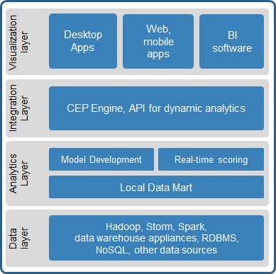
Architecture - Real time data analysis
Elements of real-time-analytics architecture:
Data collection
Data flow
Data analysis/processing
Storage
Visualization
Stack for predictive real-time analytics

Slide 9
Twitter & Facebook

Slide 10

Twitter-Storm
Framework for stream processing
Distributed
Fault tolerant
Fail-fast
Now an Apache Software
open sourced

Slide 11
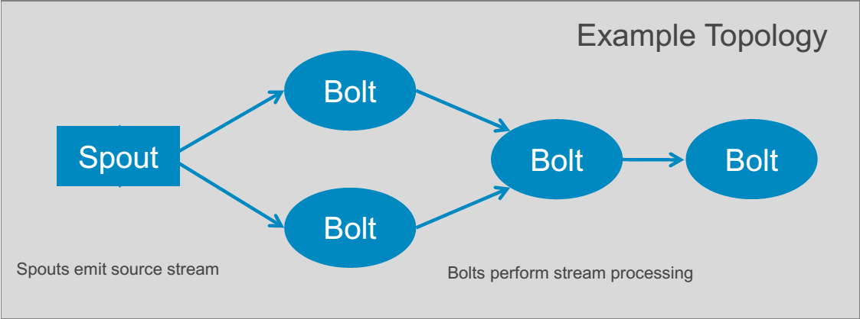
Storm - Topology

Slide 12
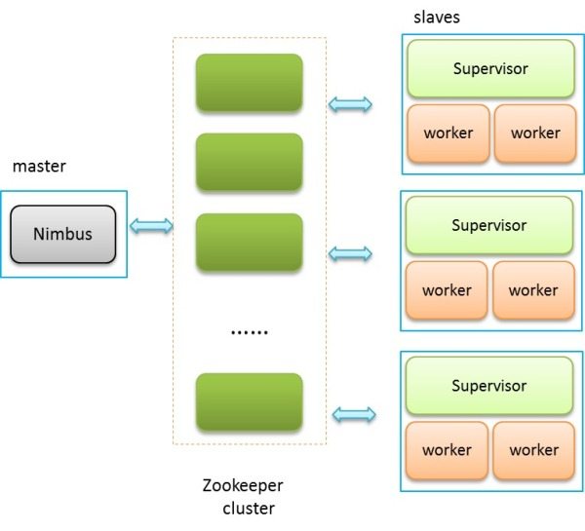
Storm-Fault Tolerance
Worker dies
Supervisor dies
Nimbus dies
No SPOF

Slide 13
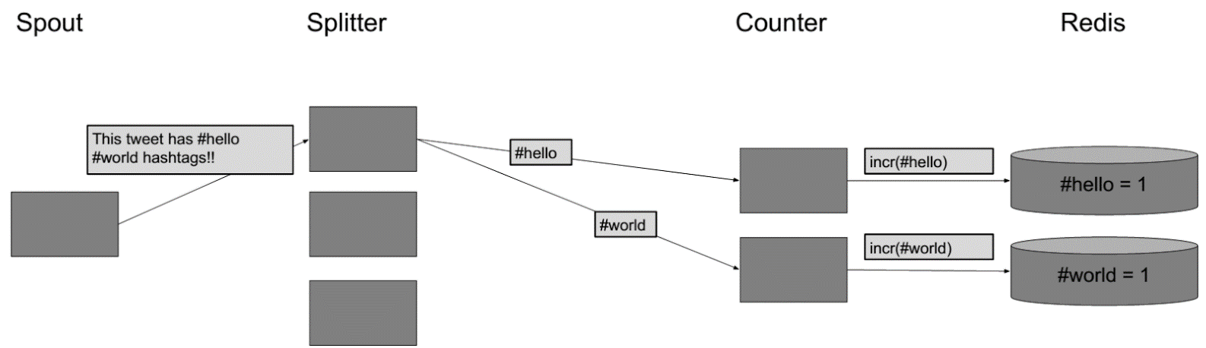
Example
How Twitter processes #hashtags in real time continuously

Slide 14
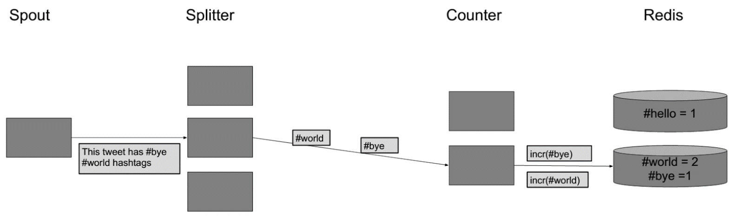
Example
How Twitter processes #hashtags in real time continuously

Slide 15


Facebook
Limited real-time processing
Low parallelization
The winner:
HBase + Scribe + Ptail + Puma

Slide 16
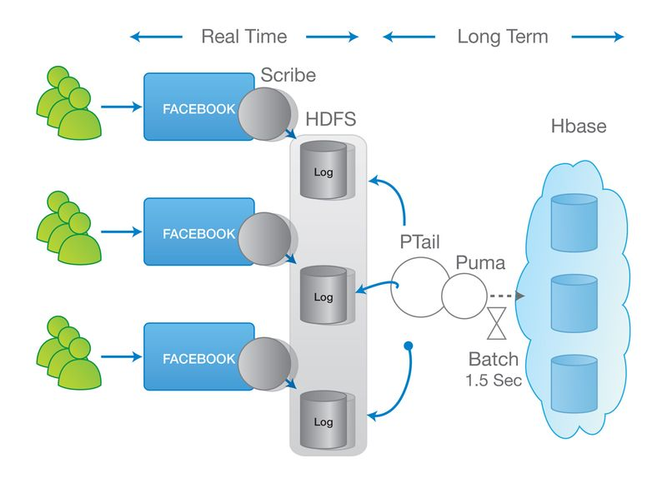
Facebook – Architecture

Slide 17
Facebook – Architecture
HBase
stores data
Scribe
server for aggregating log data streamed in real-time
Ptail
internal tool to aggregate data from scribe

Slide 18
ETL – EAI – EII

Slide 19
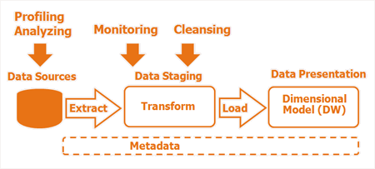
Architecture – ETL (Extraction Transformation Load)
Notes:
Extraction, Transformation, and Loading (ETL) processes are responsible for data integration from heterogeneous sources into a homogeneous schema which is optimized for data access that comes natural to human analyst.
Extraction - Convert the data into a single format which is appropriate for transformation processing.
Transformation - Series of rules applied to the extracted data to derive the data for loading into the end target. Involves cleaning of data, which aims to pass only "proper" data to the target.
Loading - loads the data into a data warehouse at regular interval of time cumulatively.

Slide 20
Real Time Data warehousing & ETL
Near Real Time - Increase the frequency of the existing data load
Direct trickle feed - Continuously feed the data warehouse with new data from the source system.
Trickle and Flip - Data is continuously fed into staging tables that are in the exact same format as the target tables.
External Real Time Data Cache - Store the real-time data in an external real-time data cache outside of the traditional data warehouse.
Notes:
Directly inserting or updating data in the warehouse fact tables.
Inserting data into separate fact tables in a real-time partition .
Trickle and flip - Staging tables either contain a copy of just the data for the current day, or for smaller fact tables can contain a complete copy of all the historical data.
On a periodic basis the staging table is duplicated and the copy is swapped with the fact table, bringing the data warehouse instantly up-to-date.

Slide 21
Challenges
Trade Off between freshness of data, overhead on source systems and guaranteed QoS of real Time systems
Significant lag in concurrency of data in warehouse.
Scalability
RTDC involves an additional database that needs to be installed and maintained
Notes:
Scalability - Constantly updating the same tables that are being queried, can cause performance to degrade. Under moderate to heavy usage, most RDMS will begin to temporarily block the incoming data transactions and the data might become stale.
RTDC involves an additional database that needs to be installed and maintained. Also there is additional work required to configure the applications that need to access the real-time data so that they point to the RTDC

Slide 22
EAI(Enterprise Application Integration)
Process of integration - integration of incompatible business application
Operate on data from across the business through API calls without regard to its location.
Message-based
Transaction-oriented
Brokering (subscriptions)

Slide 23
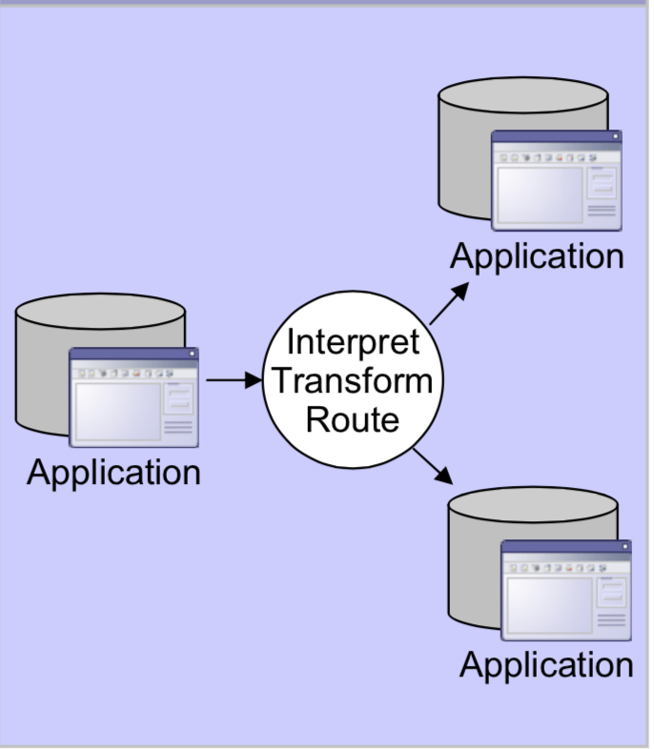
Architecture – EAI
Notes:
Extraction, Transformation, and Loading (ETL) processes are responsible for data integration from heterogeneous sources into a homogeneous schema which is optimized for data access that comes natural to human analyst.
Extraction - Convert the data into a single format which is appropriate for transformation processing.
Transformation - Series of rules applied to the extracted data to derive the data for loading into the end target. Involves cleaning of data, which aims to pass only "proper" data to the target.
Loading - loads the data into a data warehouse at regular interval of time cumulatively.

Slide 24

What is the problem?
Creating a universal repository
Creating such a data store is a relatively lengthy and expensive process
Difficult to maintain and support it
Efficient solution to this problem is EII

Slide 25
EII(Enterprise Information Integration)
Integration and communication of data across a variety of systems or applications.
Makes it possible to combine data from disparate sources in a “real-time fashion”.
EII acts as a PULL engine where data is pulled from the back end systems “on demand

Slide 26
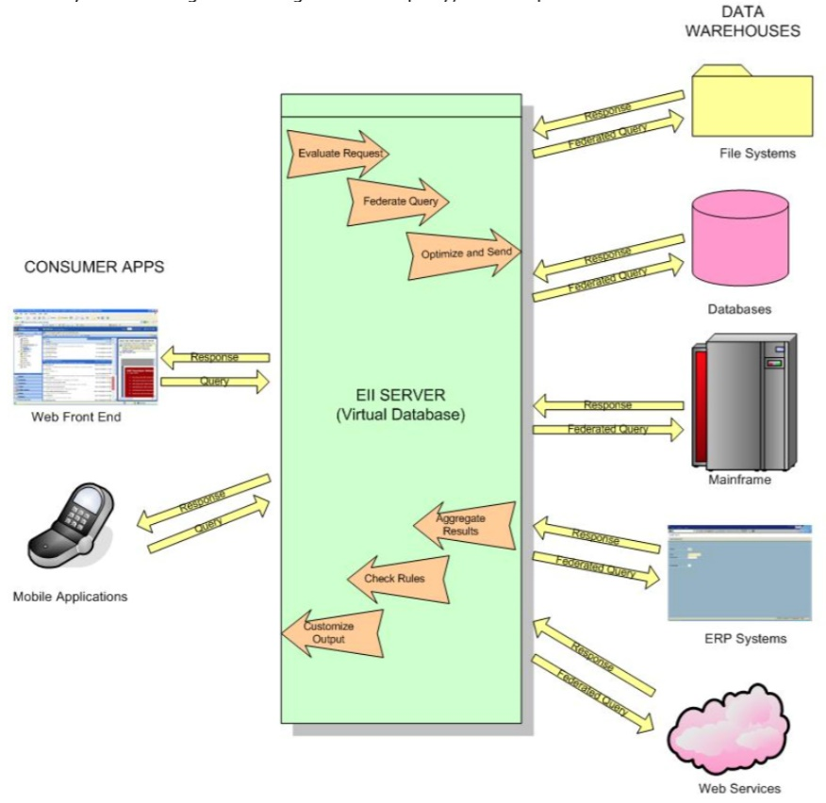
Architecture – EII

Slide 27


Pros & Cons
Pros
Acts as an abstraction layer
Real-time information to the end-user
Ability to federate data
Process data independent
Support to Service Oriented Architectures
Cons
May result in performance overheads
EII also tends to suffer from data quality problems

Slide 28
ETL vs EAI vs EII
When to use EII
When source data:
Volatility is high
Connectivity is reliable
Transformations are minimal and can be expressed as SQL
When to use EAI
Integration of transactions and not large data sets
Joining small amounts of data source repositories cannot be directly accessed
When to use ETL
Data consolidation
Complex transformations

Slide 29
Conclusion & Future Trends

Slide 30

Conclusion & Future Trends
Optimize parallel processing
Change in how data is indexed, searched and presented
EII uses federated queries
EII is able to achieve near real time but has performance overhead

Slide 31
References
Rob Weatherhead, “Say it quick, say it well – the attention span of a modern internet consumer”, February 2014
Surajit Chaudhuri, Umeshwar Dayal, Vivek Narasayya , “An overview of Business intelligence technology”, Communications of the ACM, August 2011, vol. 54, no. 8
Technology Business Research Inc.; “Data Warehouse Appliances: The next wave of IT Delivery”
Yellowfin.; "Making Business Intelligence Easy". White Paper In-Memory Analytics 2010
S. Babu and H. Herodotou, “Massively Parallel Databases and MapReduce Systems”, Foundations and Trends, R in Databases Vol. 5, No. 1 (2012) 1–104
Sai Devulapalli; "Why MPP-based Analytical Databases Are Still Key For Enterprises", October 16, 2014
Mike Barlow, Real-time Big Data Analytics: Emerging Architecture; 2013 O’Reilly Media, Inc

Slide 32
Thank you!

Slide 33

Questions

